Slide 1
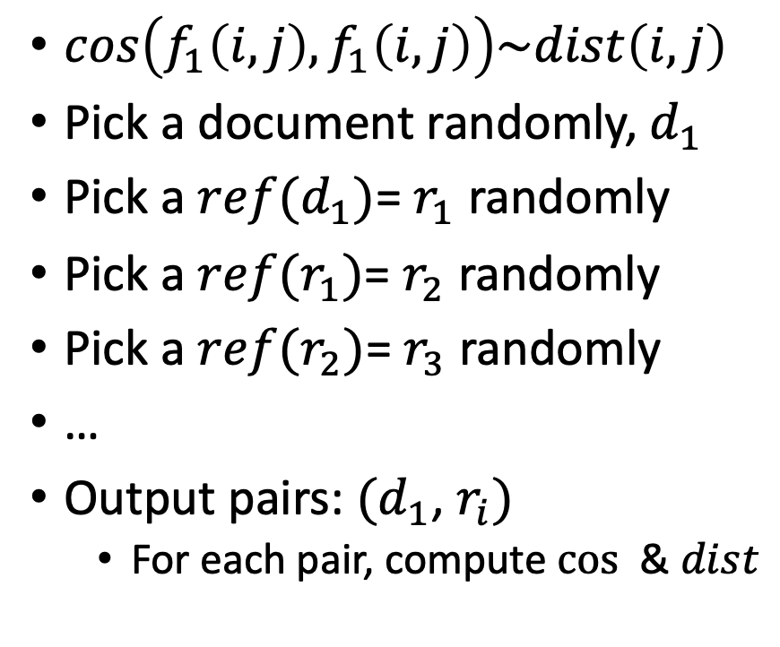
Random Walks
$cos\left(f_{1}\left(i, j\right),f_{1}\left(i, j\right)\right)\sim dist\left(i,j\right)$
Pick a document randomly, $d_{1}$
Pick a $ref(d_{1})$= $r_{1}$ randomly
Pick a $ref(r_{1})$= $r_{2}$ randomly
Pick a $ref(r_{2})$= $r_{3}$ randomly
…
Output pairs: $(d_{1}$, $r_{i})$
For each pair, compute $cos⁡$ & $dist$

Slide 2
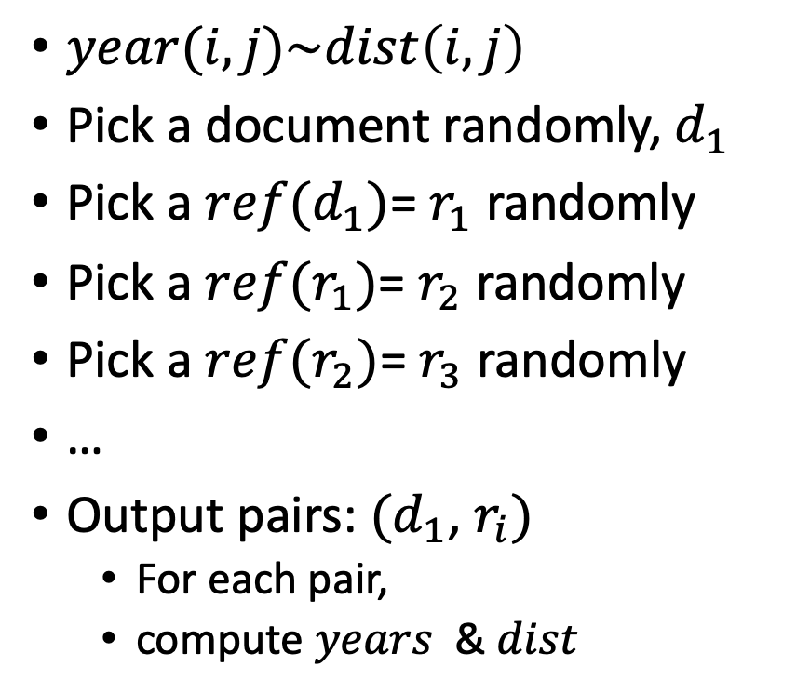
Random Walks
$year(i,j)\sim dist\left(i,j\right)$
Pick a document randomly, $d_{1}$
Pick a $ref(d_{1})$= $r_{1}$ randomly
Pick a $ref(r_{1})$= $r_{2}$ randomly
Pick a $ref(r_{2})$= $r_{3}$ randomly
…
Output pairs: $(d_{1}$, $r_{i})$
For each pair,
compute $years⁡$ & $dist$

Slide 3
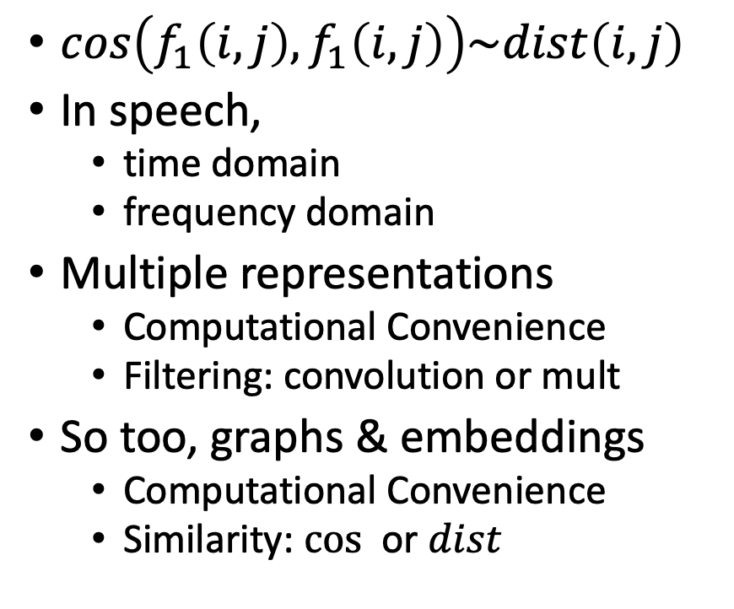
Cos-Dist: Multiple Views of Similarity
$cos\left(f_{1}\left(i, j\right),f_{1}\left(i, j\right)\right)\sim dist\left(i,j\right)$
In speech,
time domain
frequency domain
Multiple representations
Computational Convenience
Filtering: convolution or mult
So too, graphs & embeddings
Computational Convenience
Similarity: $cos⁡$ or $dist$

